Slide 1
Predicting Sales of Walmart Products
Ambika Chundru
Deep Learning (Spring, 2022)
Dr. Youakim Badr

Slide 2

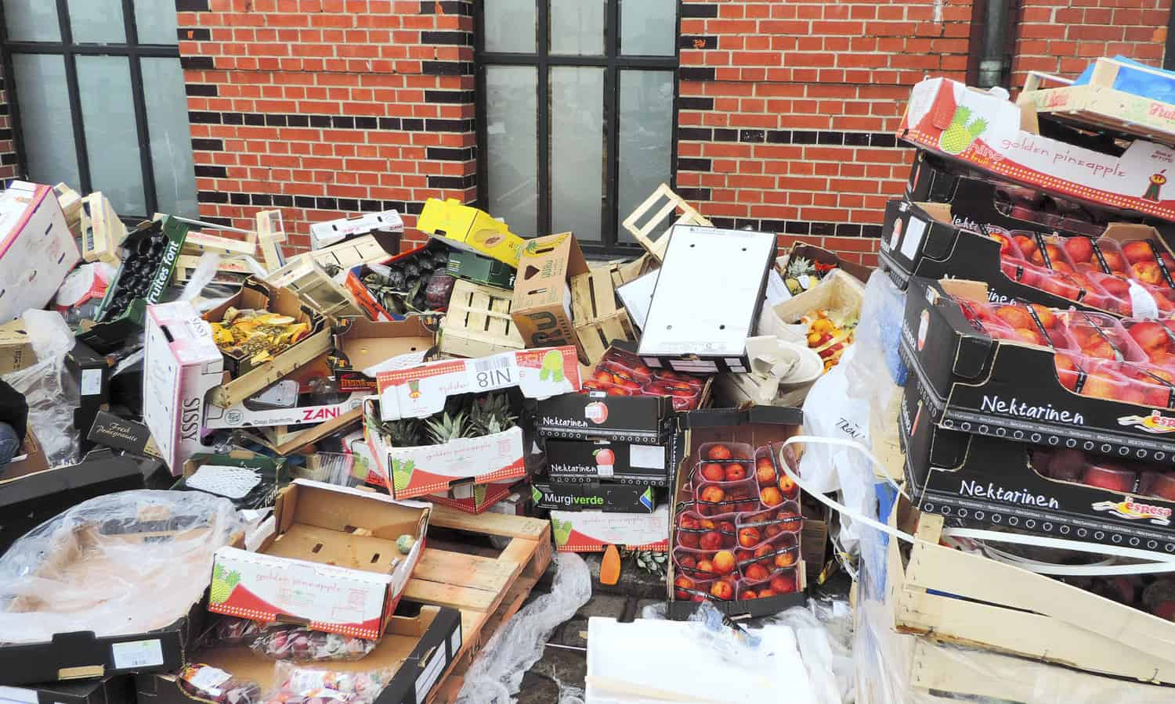

2 min to convince the audience

Slide 3

Context and Introduction
In the retail industry, forecasting sales accurately is important as this will help improve the revenue by avoiding can avoid wastages and shortages of products.
Walmart shared its historical sales data on Kaggle as an M5 competition to enhance its forecasting models.

Slide 4
Problem and Challenges
Aim:
The main objective is to estimate or predict the unit sales of Walmart retail goods at stores in various locations for the next 28-days, and 180 days.
30, 490 forecasts must be made for each day.
Challenges:
A lot of intermittent values.
Some products are introduced later.

Slide 5
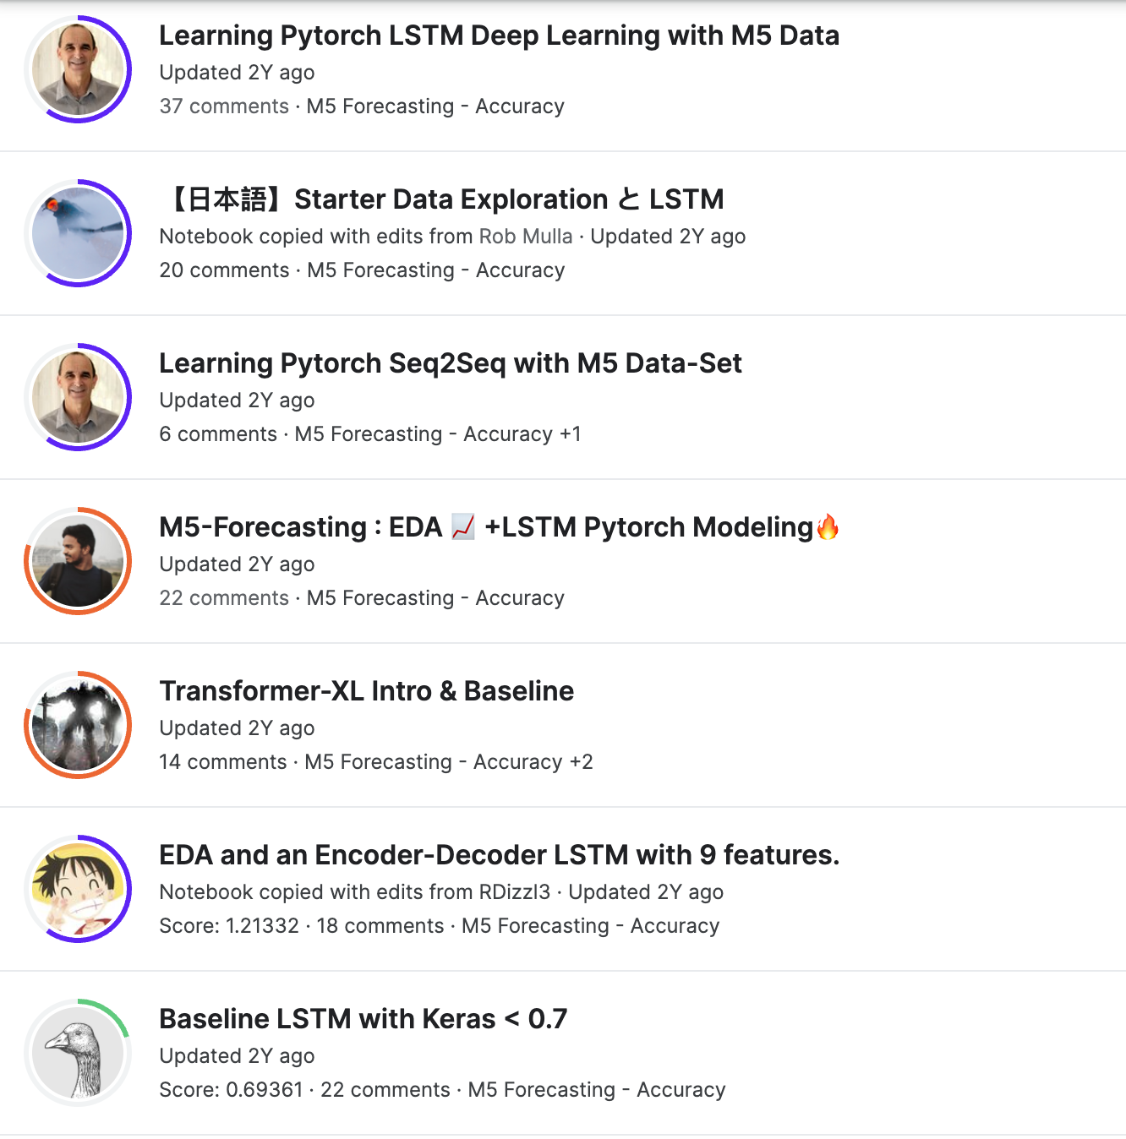
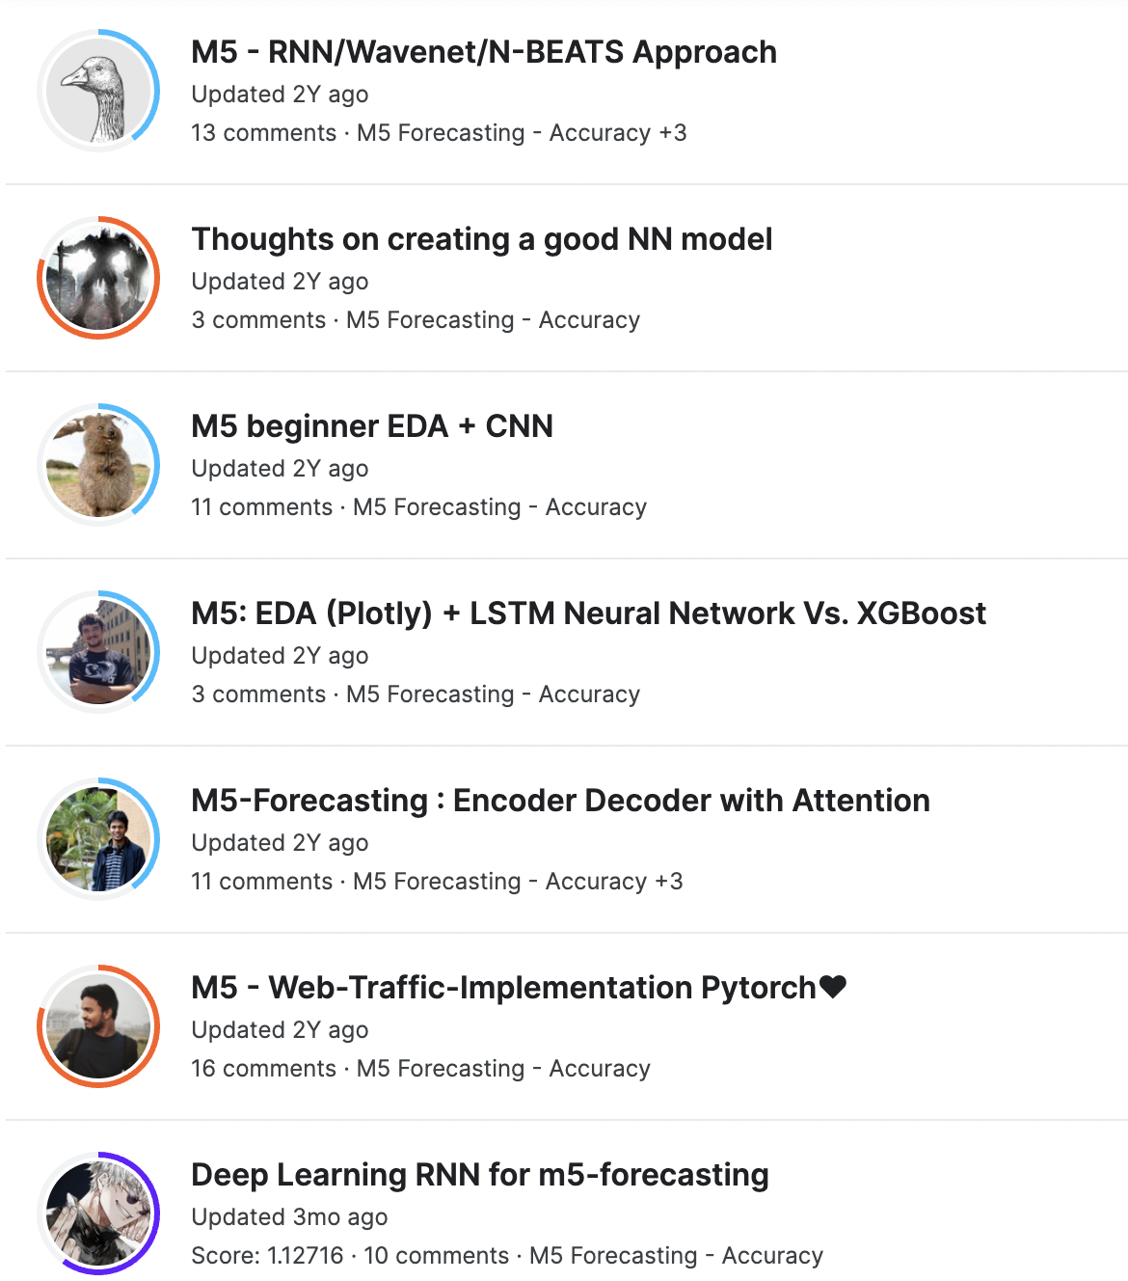
Related solutions

Slide 6
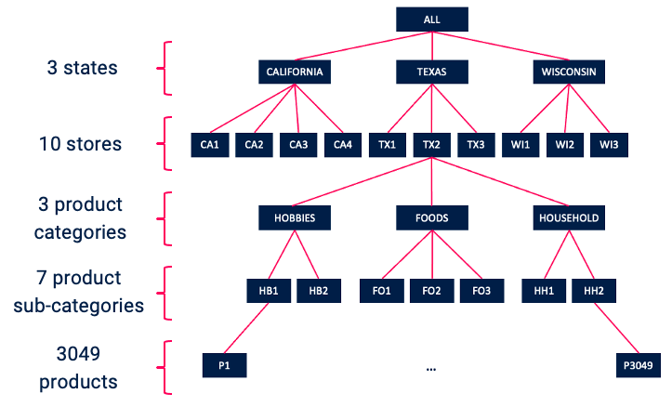
About Data
3,0490 products
3 product categories: Hobbies, Foods, and Household
7 Departments: 2, 3, 2
3 states: CA, TX, WI
10 stores: 4, 3, 3

Slide 7
Overview of Solution / Contributions
Our Solution involves 2 models CNN-LSTM model and DA-RNN model.
CNN-LSTM
CNN: To learn the local trend features and remove noise.
LSTM: To capture long temporal dependencies
DA-RNN: Dual-stage Attention-based Recurrent Neural Network

Slide 8
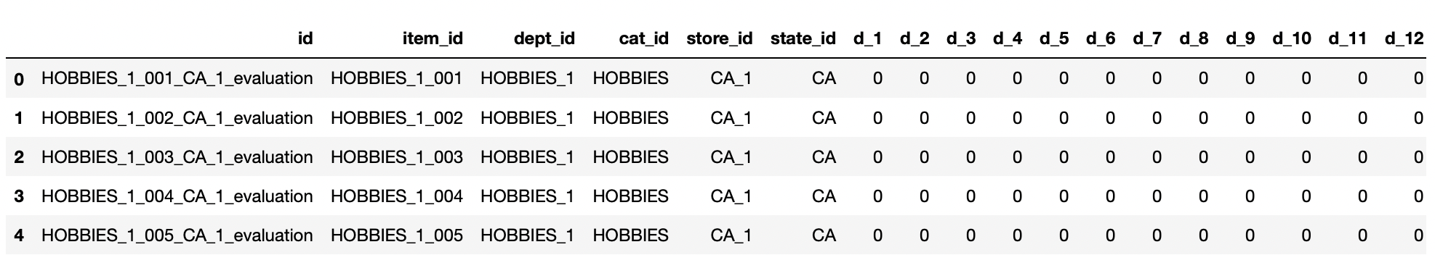
Data Collecting
The 5 years time-series sales data set of various product over various stores was published on Kaggle for the M5 completion.
The data was published by Makridakis Open Forecasting Center (MOFC) at University of Nicosia who conduct cutting-edge forecasting research and provides business forecast training.

Slide 9
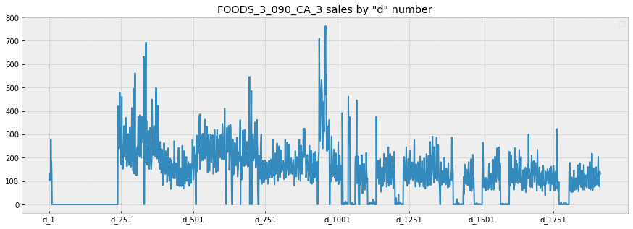
EDA
The Below graph depicts the sales of a product over 1941 days.
0 sales indicate that the item is out of stock.

Slide 10
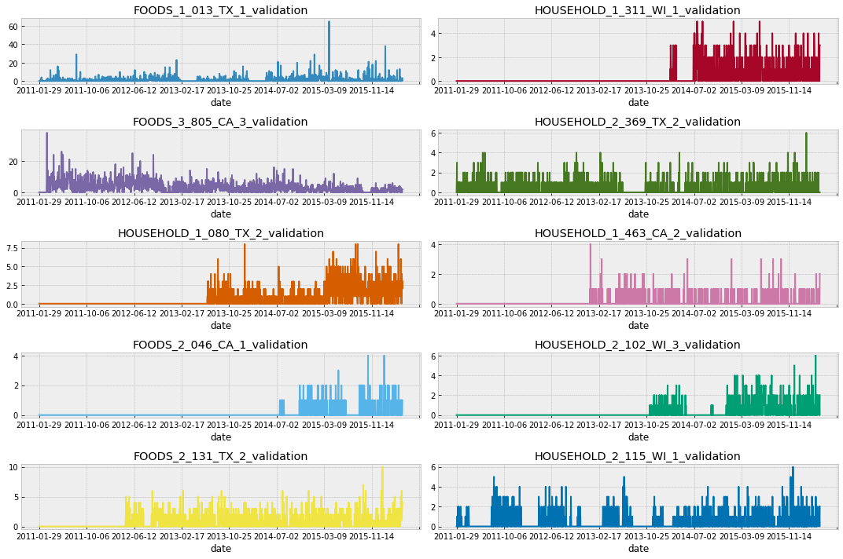

Slide 11
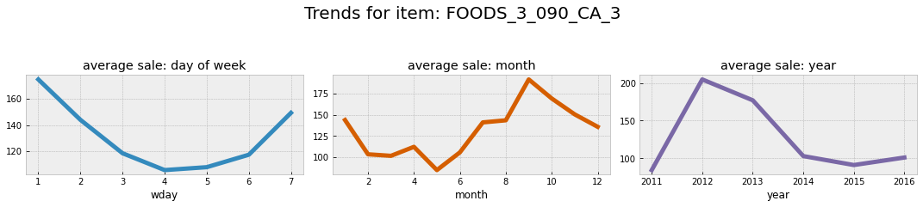
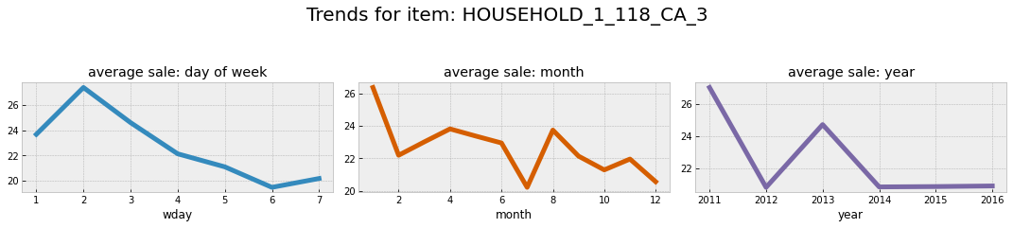
The below graphs give us a understanding of sales over different time components :
Week
Month
Food Item
Household Item

Slide 12
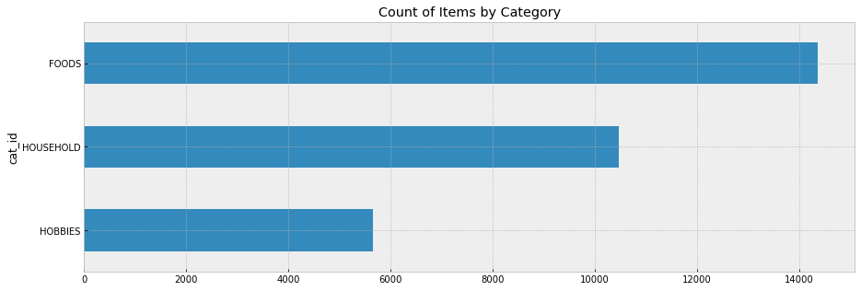
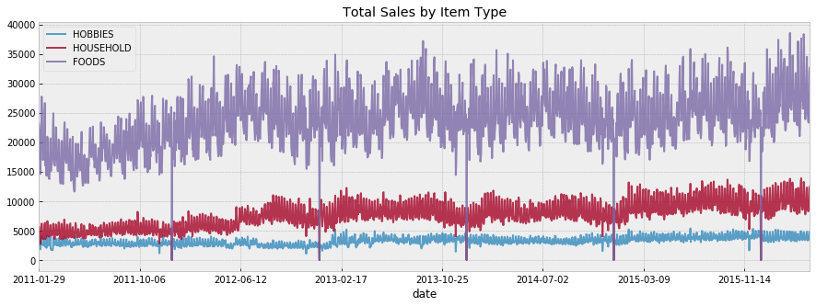
From the graph we see the number of unique products in each category

Slide 13
Data Preprocessing
Backfill Sales for out of stock products
Downcasting
Remove the first 350 days due to zero inflated data
Add features : One day before event, SNAP
Creating training, validation, evaluation dataset
Standardize features through scaling

Slide 14
CNN-LSTM Methodology
CNN models is used to filter out the noise of the input data and extract more valuable features.
LSTM models efficiently capture sequence pattern information for long-range prediction.
We are adding Conv1D as our convolutional layer since we are dealing with a one-dimensional sequence.
A filter is applied to the sequence to highlight certain features which are important.
The pooling layer applies max function to the sections of the sequence. Pooling drastically reduces the size going into the next layer.

Slide 15
CNN-LSTM Methodology
In short, the gated cell architecture keeps memory of important information uncovered earlier in the sequence of time steps.
Bidirectionality will allow the LSTM to learn the input sequences both forward and backwards. In the backwards run, the bidirectional LSTM network preserves information from the future.
Batch Norm is a normalization technique done on mini batches between the layers of a Neural Network. It helps to speed up training process and stabilizing the learning process

Slide 16
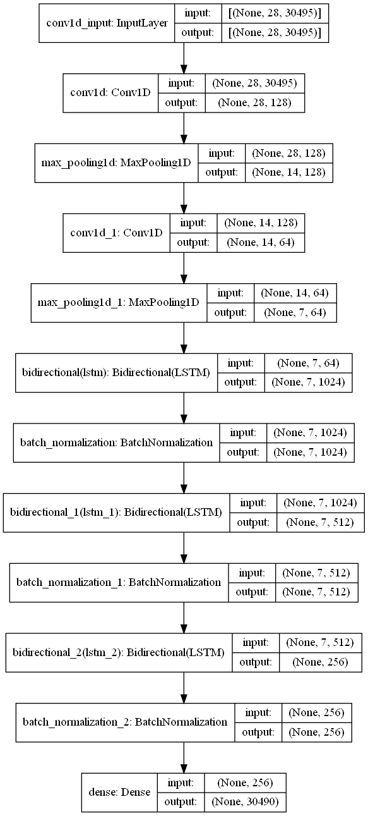
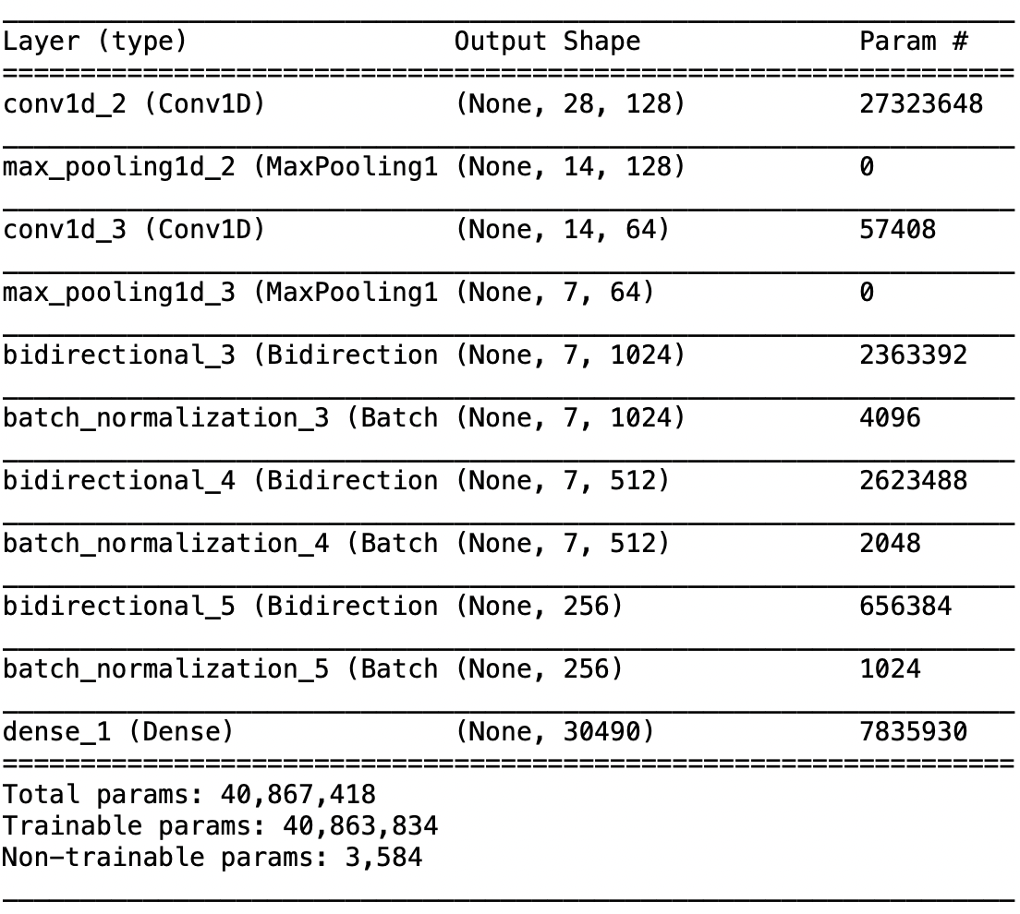
CNN-LSTM Summary

Slide 17
Parameter calculation
Conv1D Params = kernel size*input_depth*filters+bias
=7*30495*128+128
= 27323648
LSTM params = 4*((sizeofinput + 1)*sizeofoutput+ sizeofoutput^2)
=4*(65*512+512*512)
= 1181696
Since it is a bidirectional LSTM, total params= 2*1181686
=2363392
Batch normalization maintains the input shape

Slide 18
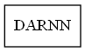
DA-RNN Methodology
One problem with encoder-decoder LSTM networks is that their performance will deteriorate rapidly as the length of input sequence is large.
The attention-based encoder-decoder network uses an attention mechanism to select parts of hidden states i.e It takes all window size sales into account then assigning relative importance to each one of them.
There are three parameters in the DA-RNN, i.e., the number of time steps in the window T, the size of hidden states for the encoder m, and the size of hidden states for the decoder p. We took time steps as 28, and did grid search over encoder and decoder layers to find 64 encoder/decoder size gave the best performance over val data.

Slide 19
Model Hyperparameter Comparisons
 | CNN_LSTM | DA-RNN
Optimizer | Adam | Adam
Loss Function | MSE | MSE
Metric | MAE, MSE | MAE, MSE
Batch Size | 64 | 16
Time per epoch | 65 sec | 17 sec
Total epochs | 56 | 13
Total Time | 60 min | 3.6 min

Slide 20
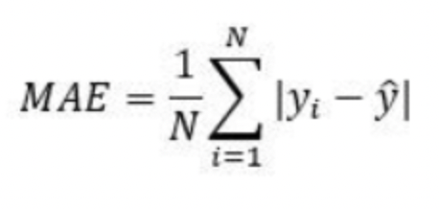
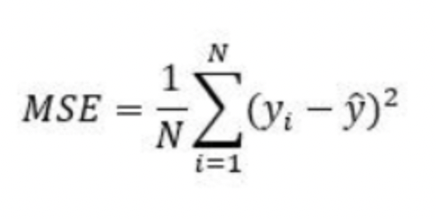
Model Evaluation
MAE:
MSE:
 | CNN-LSTM | DA-RNN
MAE | 1.44 | 1.43
MSE | 16.83 | 16.08

Slide 21
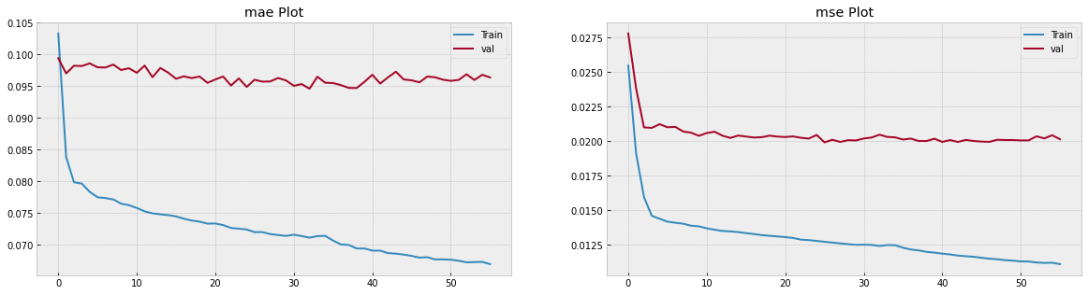
Training Validation Loss Plots CNN-LSTM Model

Slide 22
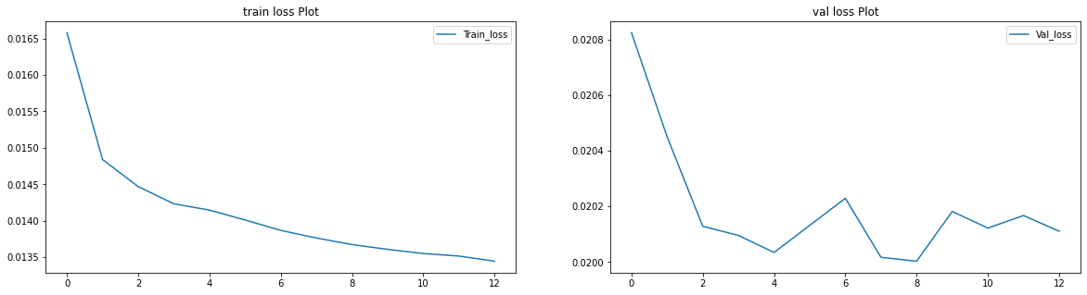
Training Validation Loss Plots DA-RNN Model

Slide 23
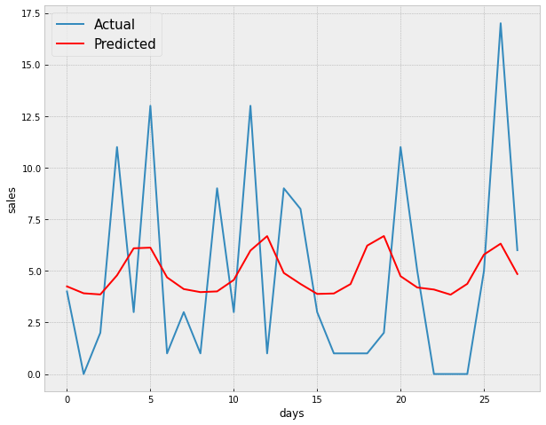
CNN-LSTM Outcomes (28days)

Slide 24
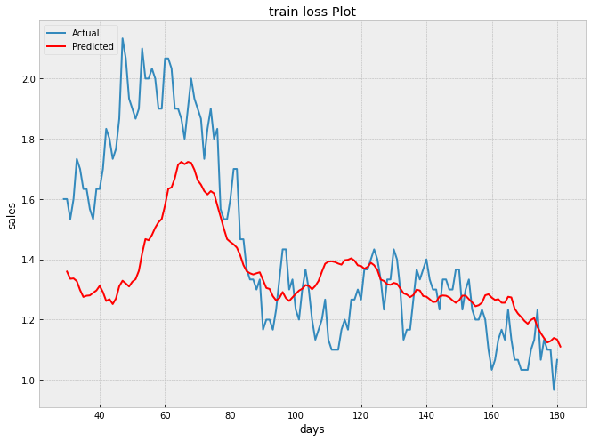
CNN-LSTM Outcomes(180 days)

Slide 25
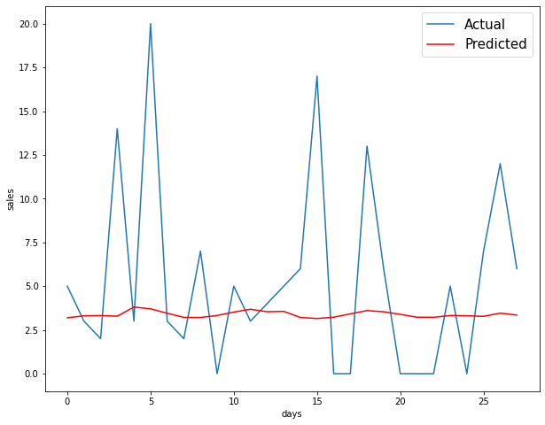
DA-RNN Outcomes (28days)

Slide 26
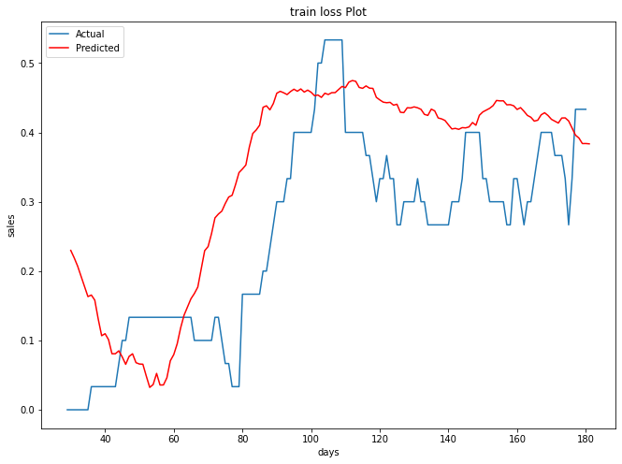
DA-RNN Outcomes(180 days)

Slide 27
Lessons learned and Perspectives
Future work and improvements:
Add more features for improving predictions. Through feature engineering we could embed season, quarter, month start/end, day of the week and week of the month.
Moving standard deviation could also be explored.

Slide 28
Bibliographical References
Livieris, Ioannis E., Emmanuel Pintelas, and Panagiotis Pintelas. "A CNN–LSTM model for gold price time-series forecasting." Neural computing and applications 32.23 (2020): 17351-17360.
Lu, Wenjie, et al. "A CNN-LSTM-based model to forecast stock prices." Complexity 2020 (2020).
Qin, Yao, et al. "A dual-stage attention-based recurrent neural network for time series prediction." arXiv preprint arXiv:1704.02971 (2017).
Ensafi, Yasaman, et al. "Time-series forecasting of seasonal items sales using machine learning–A comparative analysis." International Journal of Information Management Data Insights 2.1 (2022): 100058.

Slide 29


